Slide 1


Instruction Manual
Version 5 January 17, 2021
Naoya Yamazaki

Slide 2





Program Package
This package includes:
packcnn5
main5.py
scraper5.py
testseparator5.py
cnn5.py
chomedriver.exe ---------------------Note
hyperparam_init.xlsx
readme5.pdf
pics
Note; This chromedriver version is ChromeDriver 87.0.4280.88.
Please check version of your Google Chrome browser, and if not version 87, please download correct version from URL below then replace chomedriver.exe under ‘packcnn5’.
[Chromedriver download site] https://sites.google.com/a/chromium.org/chromedriver/downloads

Slide 3
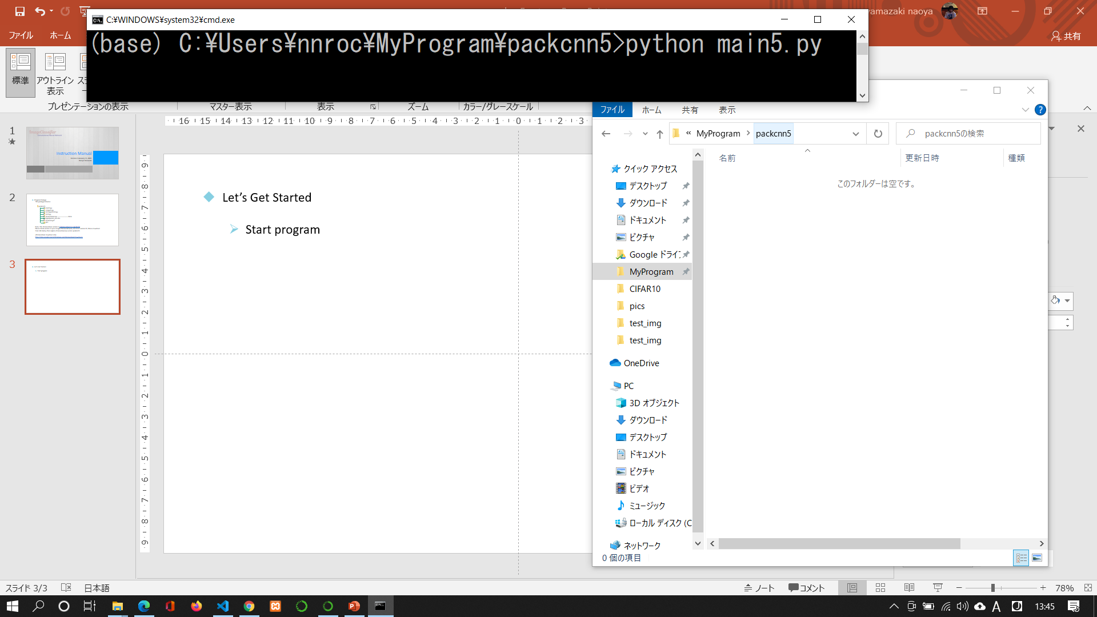
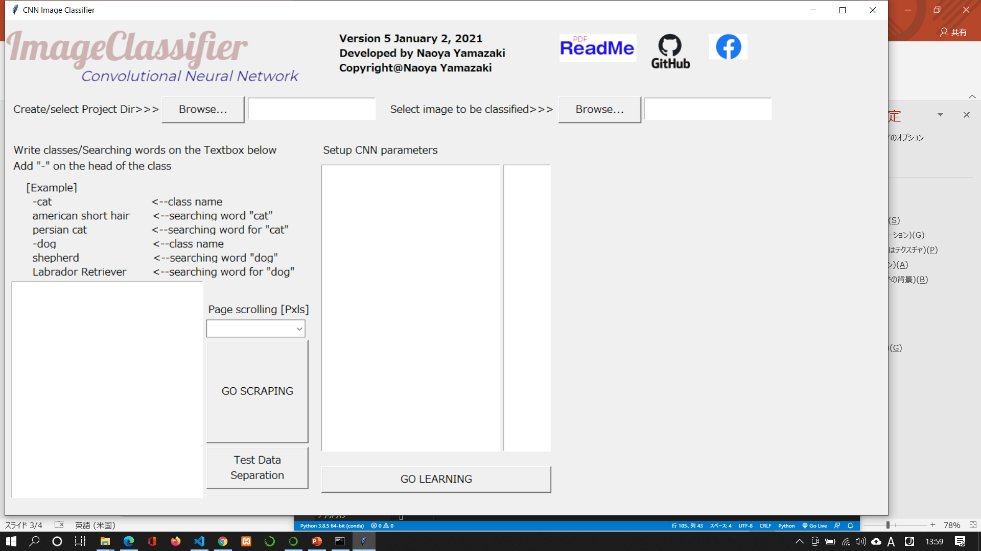
Let’s Get Started
Unzip ‘packcnn.zip’ on your work directory.
Execute ‘python main5.py’ on ‘packcnn5’ directory
Then you can get the window as below

Slide 4
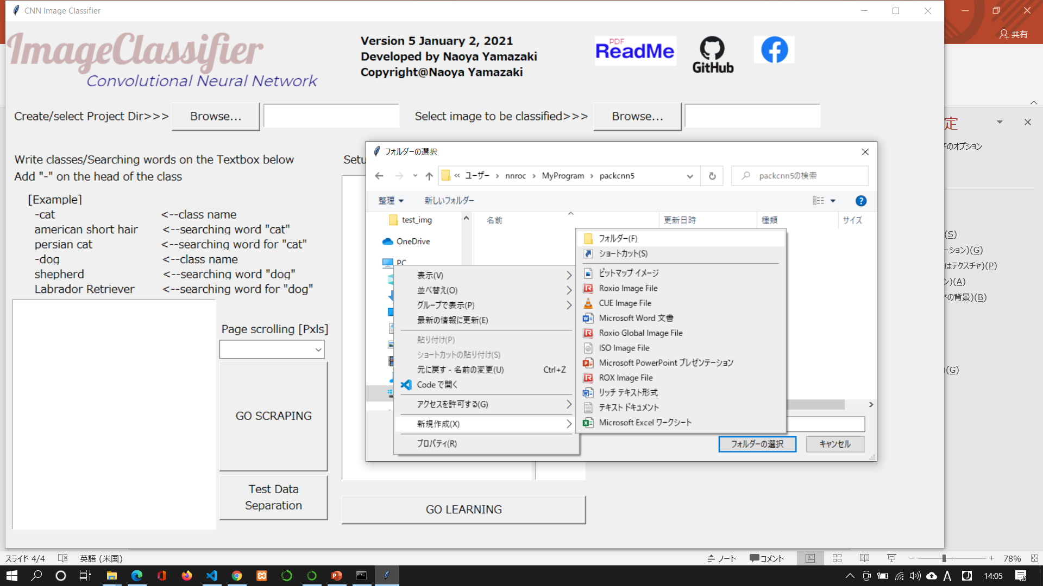
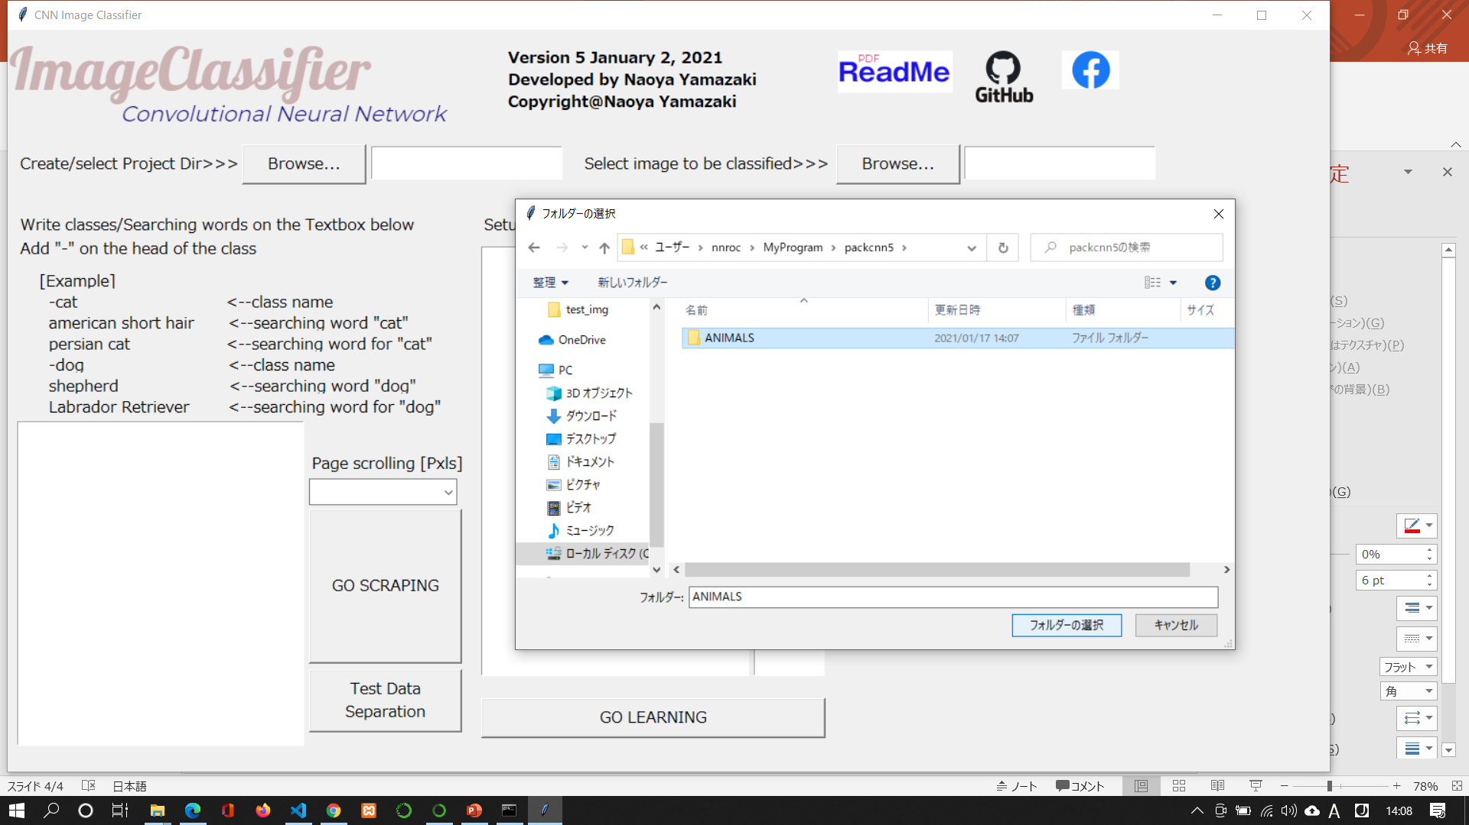

Create Project
First of all, you need to create PROJUCT DIRECTORY on any place on your computer.
(1)
(5)
(2)
(3)
(4)

Slide 5
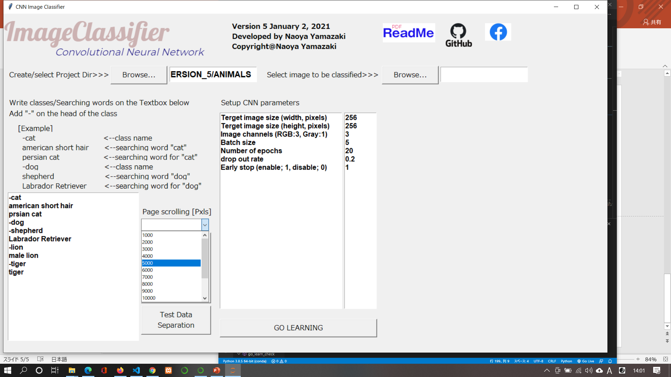
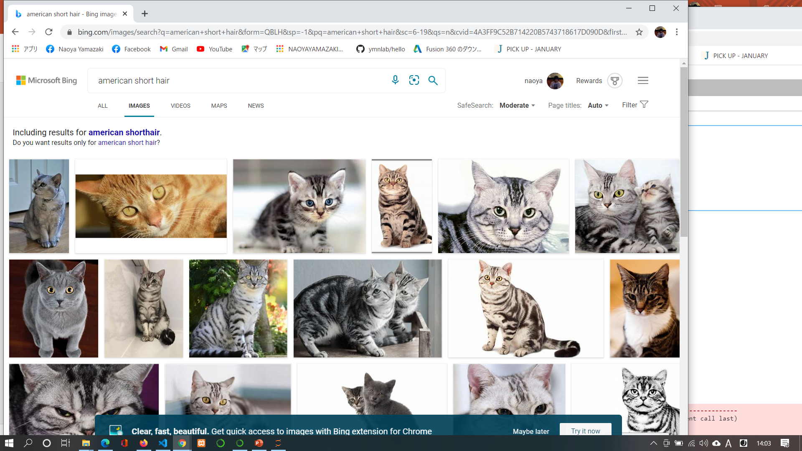
Scraping from web site
You can gather a lot of image files from Microsoft Bing by web scraping technic.
If you want to gather ‘cat’, ‘dog’, ‘lion’ and ‘tiger’ to classify, refer to the Example below.
Add ‘-’ on the head of the words to be classified
Under the words of class, write searching words
searching words for example, ‘American short hair’ for class ‘cat’.
Set scrolling screen (pixels)
After scraping, you can separate 10% image files at random from each class for accuracy verification

Slide 6
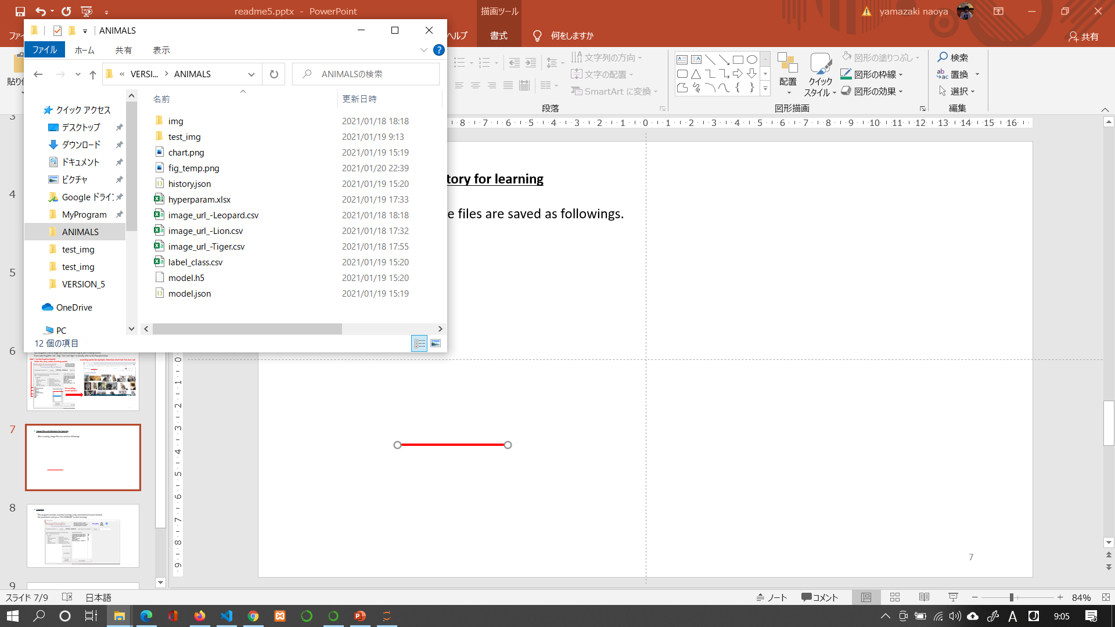
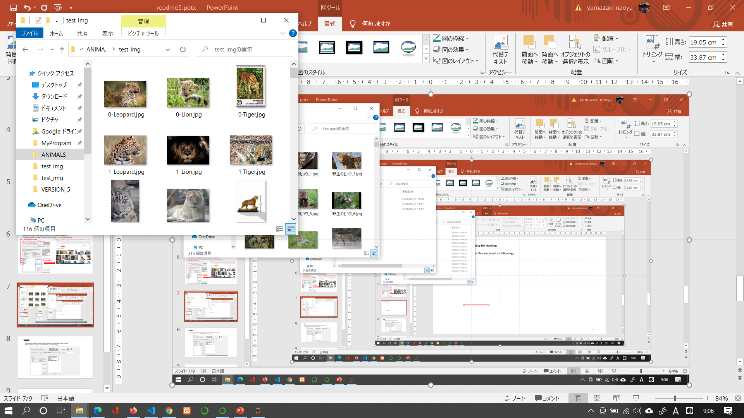
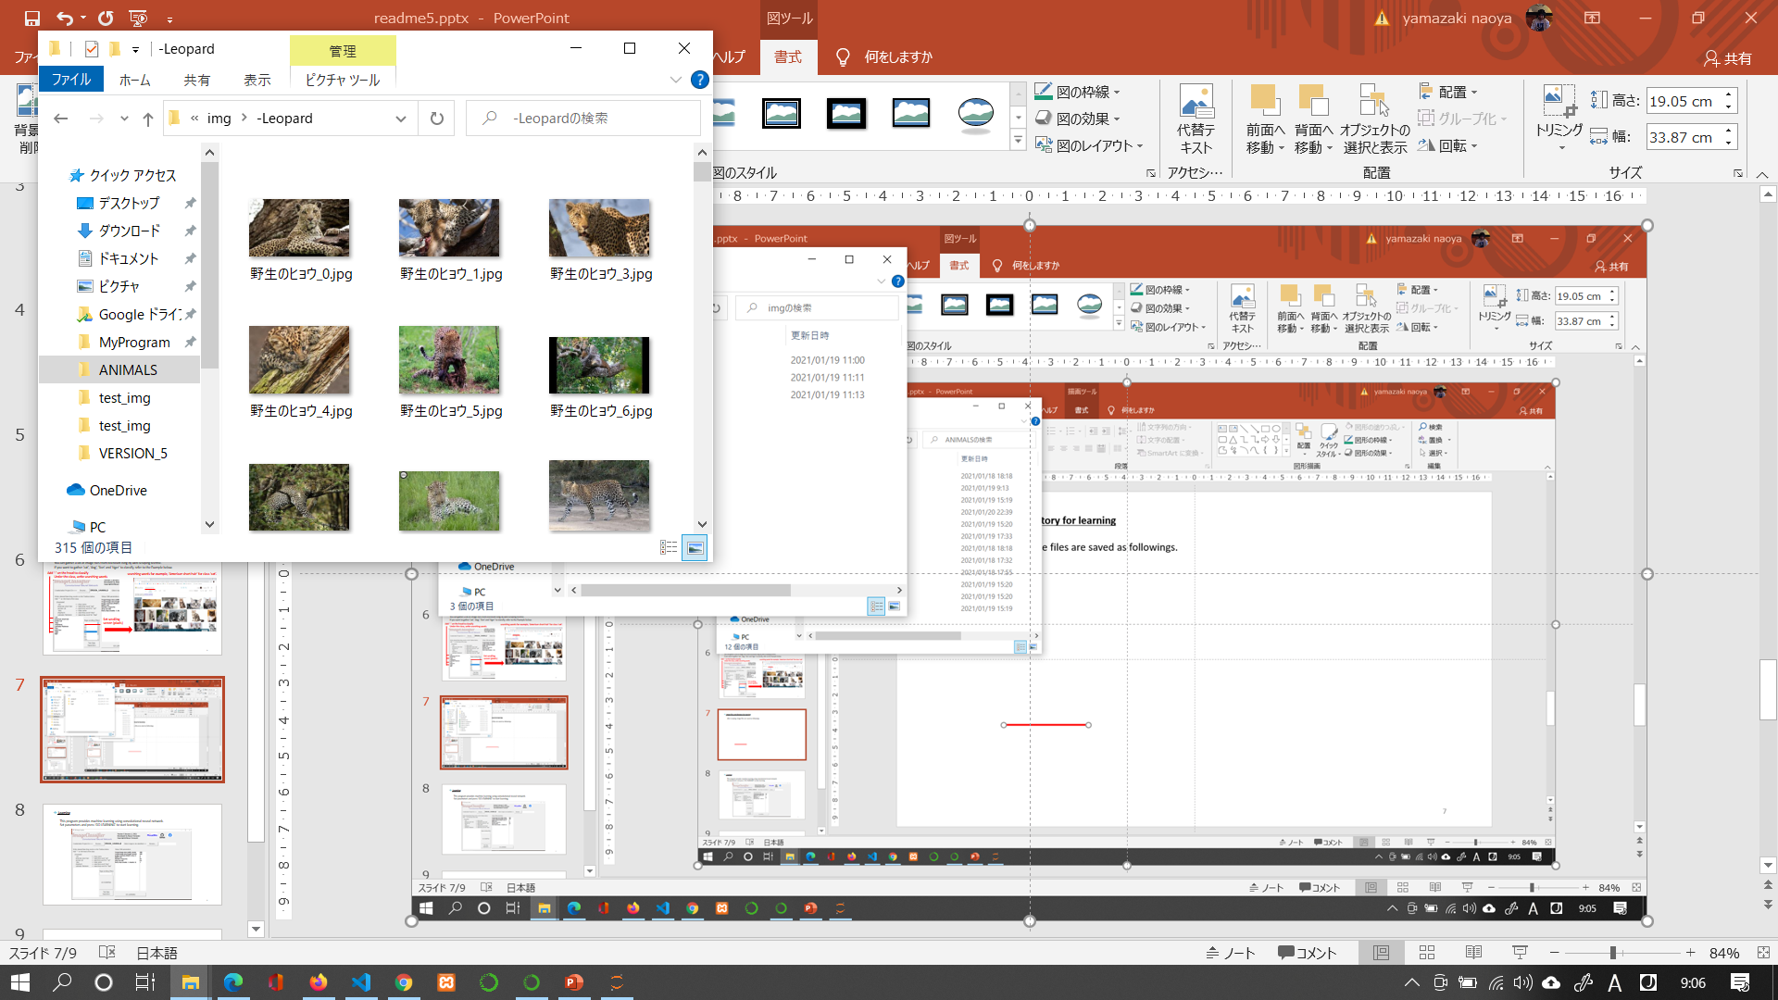
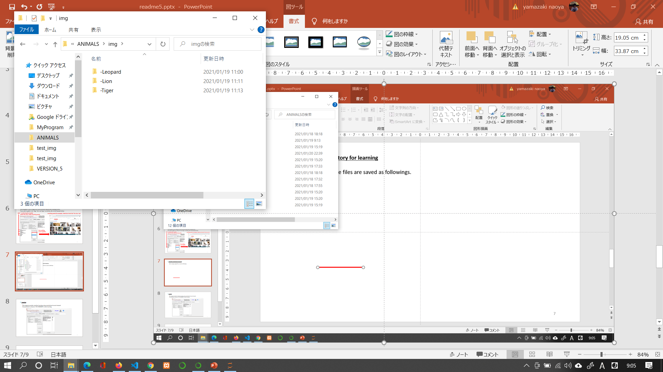
Image files and directory for learning
After scraping, image files are saved under the ‘Project Directory’ as followings.
Directory ‘img’ for learning
Directory ‘test_img’ for accuracy verification (10% separated at random)
Classes

Slide 7
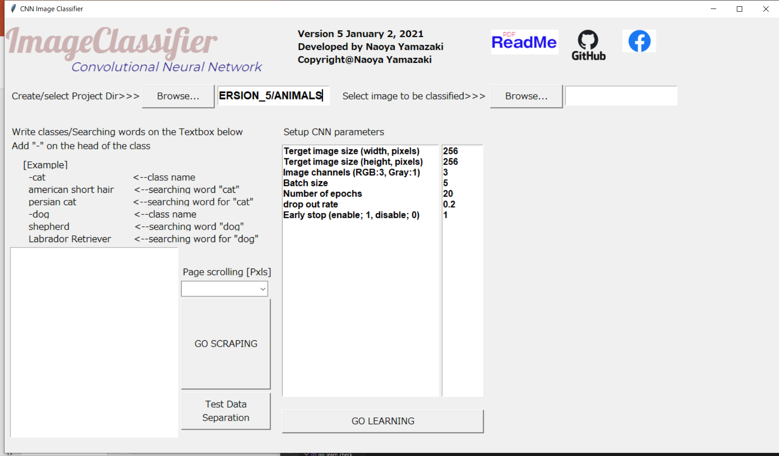
Learning
This program provides machine learning using convolutional neural network.
Set parameters and press ‘GO LEARNING’ to start learning.

Slide 8
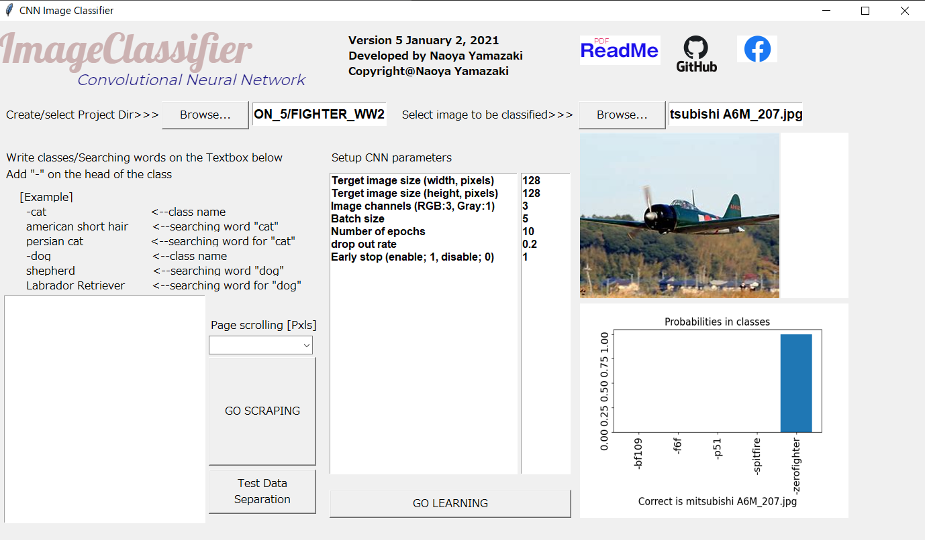
Classifying
Enjoy classifying any images. Choose any images or use the files under ‘test_img’.

Slide 9
Model of Convolutional Network (CNN)
Layer 1 Conv2D filter = 32, kernel size = (3,3) activation function = relu
Layer 2 MaxPooling2D pool size = (2, 2)
Layer 3 Dropout rate = user defined
Layer 4 Conv2D filter = 64, kernel size = (3,3) activation function = relu
Layer 5 Conv2D filter = 64, kernel size = (3,3) activation function = relu
Layer 6 MaxPooling2D pool size = (2, 2)
Layer 7 Dropout rate = user defined
Layer 8 Flatten
Layer 9 Dense node = 512 activation function = relu
Layer 10 Dropout rate = user defined
Layer 11Dense output number of classes activation function = softmax
Loss function categorical cross-entropy
Optimizer RMSprop
Softmax; y_{i} = e^{xi} / Σ_{j}^{N} e^{xj}
Where, y_{i} is output tensor, x_{j} is input tensor. This function shows gradient curve from 0 to 1 to describe probability for each class.

Slide 10
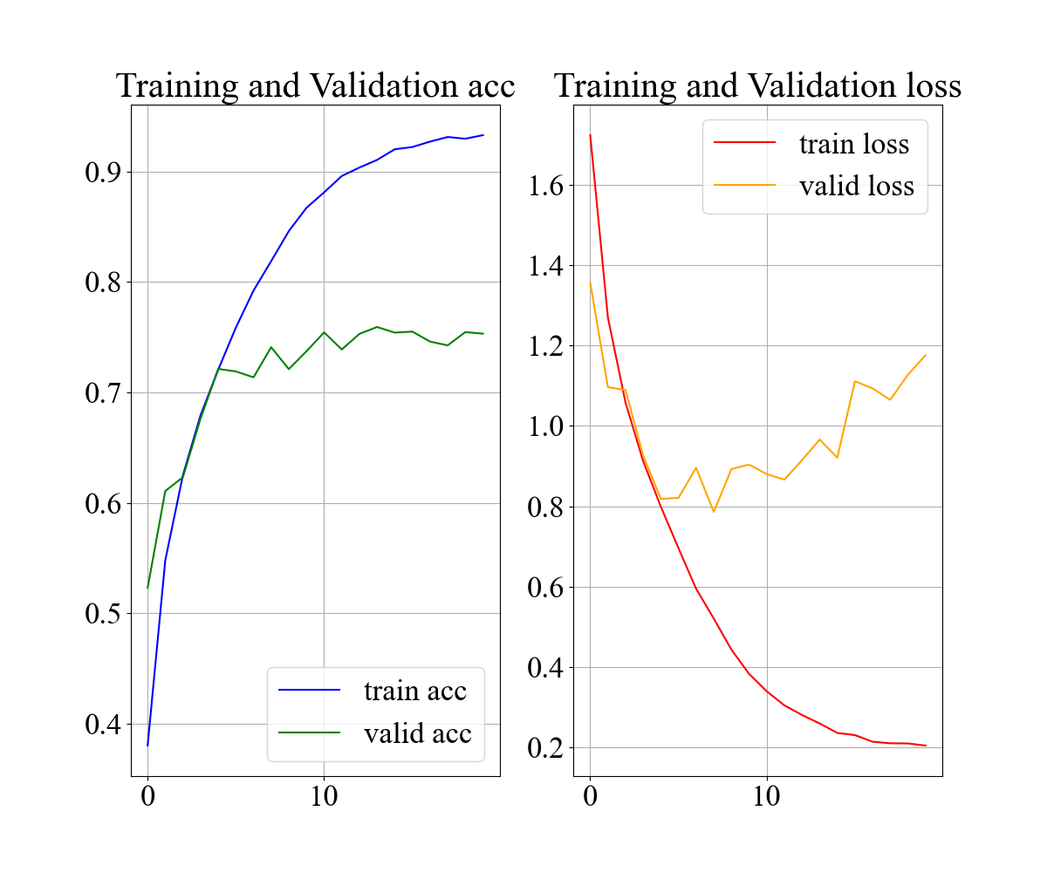
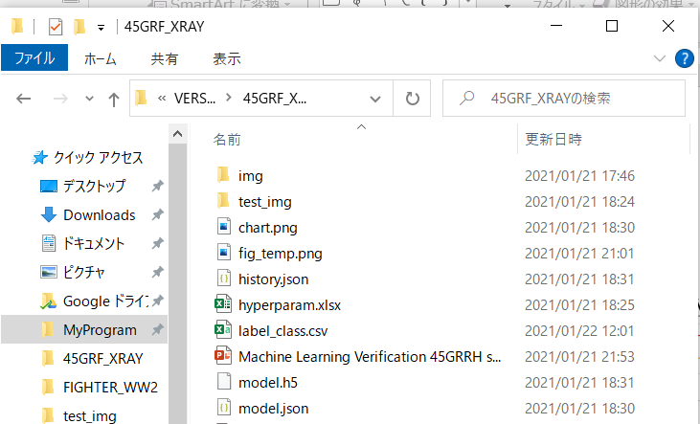
Output Files
You will get output files under the PROJECT DIR as below.
PROJECT DIR
chart.png -------- epoch vs accuracy, loss
history.json ----- learning log
model.json ------ model summary
model.h5 -------- total neural network tensor
Chart.png

Slide 11
Necessary Library
You need to install necessary python library as below.
tkinter
urllib
matplotlib
numpy
pandas
requests
Keras
tensorflow
Pillow
selenium
Sklearn
BeautifulSoup4

Slide 12
Thank you

